Slide 1


Slide 2

Mini Project (05MC0304)
True Card
Team Member 1: Harsh Bhupatkar (92400584097)
Team Member 2: Uday Sheth (92400584080)
Team Member 3: Vishal Patel (92400584081)
Guided By
Internal Guide: Prof. Jaypalsinh Gohil
Faculty of Computer Application

Slide 3
Outline
Introduction to True card
Project Summary
Technology Used
Literature Review
System Architecture
Key Features
Flow Chart
Case Model
Learning Outcomes and Ethical Consideration
Future Enhancement and Integration Opportunist
References

Slide 4
1. Introduction to True Card
True Card is a smart recommendation system that analyzes user spending patterns to suggest the most suitable credit cards, maximizing rewards and minimizing costs. It simplifies decision-making for both new and existing cardholders, ensuring personalized, data-driven financial choices.
The aim is to simplify the credit card selection process through data-driven recommendations that maximize benefits for users. Initially, the system uses rule-based logic, such as matching high fuel spenders with cards offering fuel surcharge waivers, but it can also be enhanced with machine learning for smarter insights.
Save money, save time, and Choose cards more wisely with our easy-to-use and effective credit card comparison tool!
Why to Concern?
Wastes Time: Manually checking prices across platforms is time-consuming.
Higher Costs: Users risk paying more or losing rewards without proper comparison.
Overwhelming Choices: Too many platforms make it hard to decide where to buy.

Slide 5
2. Project Summary
Problem Statement
Choosing the right credit card is difficult due to the wide variety of cards offering different rewards, benefits, and fees across categories like groceries, travel, fuel, and dining. Users often end up with unsuitable cards, leading to lost rewards and higher costs.
Solution Approach
True Card provides an intelligent recommendation system that analyzes user income and spending patterns to suggest the most suitable credit cards. Using a Firebase database and rule-based logic, it delivers personalized results through a simple and user-friendly interface.
Target Users
The system is designed for new users seeking their first credit card and existing cardholders who want to optimize their portfolios. It also helps financially aware individuals make smarter decisions by maximizing rewards and minimizing unnecessary fees.

Slide 6
3. Technology Used
Technology | Purpose | Version/type | Platform Compatibility | Key Benefits
Flutter Franework | Cross-Platform Development | SDK 2.0+ | Android | Fast development
Fire Base | Real-Time Database | Cloud Database | Web/Mobile | Scalable Storage
Android SDk | Mobile Development | Version 7+ | Android Devicesw | Native Features
Shared Preferences | Local Storage | Built in | Android | Offline Access

Slide 7
3. Literature Review
Current Challenges | Research Solutions
Generic credit card recommendation lacking personalization features | Personalized Recommendation system behavioural Segmentation
Complex reward structures confusing consumer decisions | Machine learning algorithm for pattern recognition
Limited integration of behavioural spending pattern analysis | Hybrid filtering approaches improving recommendation accuracy

Slide 8
5. Systems Architecture
User Input Module:- Collects user’s personal and financial details (like income, spending categories, employment status) and stores them locally (SharedPreferences). This ensures privacy and allows offline functionality.
Firebase Offer Database Module :– Stores predefined credit card offers in a structured way (card name, features, eligibility, fees, etc.). It allows dynamic updates without app updates and acts as the central data source for recommendations.
Card Recommendation Logic Module :– Matches user inputs with credit card offers from Firebase. It filters based on eligibility and spending categories, then recommends the best card to maximize rewards and cashback.

Slide 9
6 Key Features
The True Card system is designed to be a smart and reliable tool that helps users find the most suitable credit card based on their spending patterns and income. By analyzing category-wise expenses and mapping them with predefined offers stored in Firebase, the system provides personalized recommendations that maximize rewards and benefits.
The integration of a modular design ensures efficiency, where user input, database management, and recommendation logic operate seamlessly together. With a simple and user-friendly interface built using Flutter, users can easily enter their details and instantly view the best card options in a visually appealing card-like display.
In addition, the system incorporates error handling to ensure smooth performance even in cases of invalid input or network issues. Its scalable architecture also makes it adaptable for future enhancements, such as AI-based recommendations, real-time expenditure tracking, and integration with more financial platforms to further improve accuracy and usability.

Slide 10
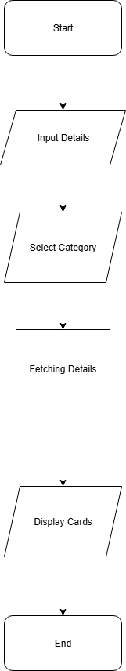
7 Flow chart
Approach:

Slide 11
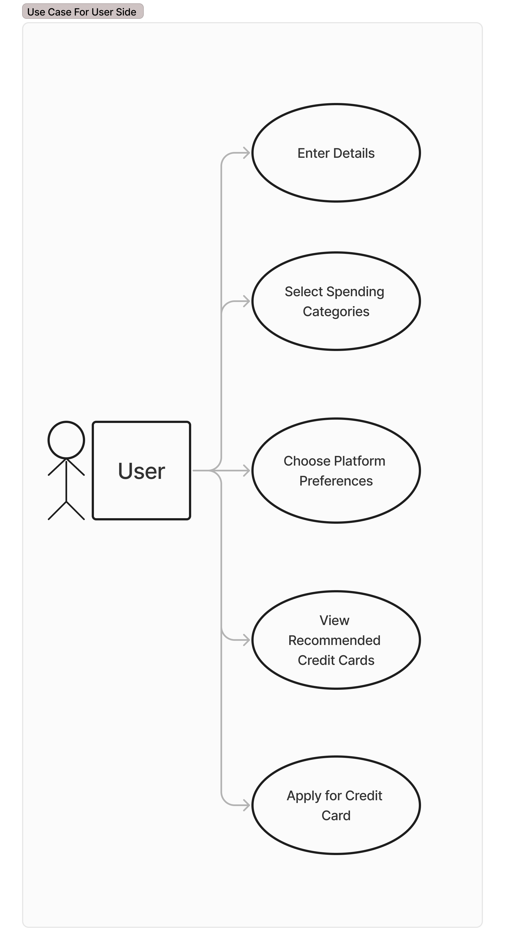
8 Case Model
Approach:

Slide 12
9 Learning Outcomes and Ethical Consideration
Enhanced Technical Skills
Gained expertise in Flutter app development, Firebase integration, and building a recommendation system.
Improved Soft Skills
Strengthened teamwork, problem-solving, and project management abilities during development.
Ethical Framework Awareness
Understood the importance of data privacy, transparency, and fairness in financial applications.

Slide 13
10 Future Enhancements and Integration Opportunities
Banking Integration
Technical Resources
Business Exploration
Direct API integration with major banks
Real-time credit score monitoring services
Automated application processing and status tracking
Artificial and Machine learning algorithm
Blockchain integration for secure transactions
Voice Assistant and chatbot Implementation
B2B Partnerships with Financial Advise
White label solutions for banks and instructions

Slide 14
11 References
Flutter: https://flutter.dev/docs
RBI: https://www.rbi.org.in
Chatgpt:- chatgpt.com
Youtube: https://www.youtube.com/

Slide 15


